Slide 1
MULTIPLEXING TECHNIQUES

Slide 2
Whenever the bandwidth of a medium linking two devices is greater than the bandwidth needs of the devices, the link can be shared.
Multiplexing is the set of techniques that allow the simultaneous transmission of multiple signals across a single data link.
As data and telecommunications use increases, so does traffic.
We can accommodate this increase by continuing to add individual links each time a new channel is needed

Slide 3
In a multiplexed system, n lines share the bandwidth of one link.
The lines on the left direct their transmission streams to a multiplexer (MUX), which combines them into a single stream (many-to one).
At the receiving end, that stream is fed into a demultiplexer (DEMUX), which separates the stream back into its component transmissions (one-to-many) and directs them to their corresponding lines.
The word channel refers to the portion of a link that carries a transmission between a given pair of lines.
One link can have many (n) channels.

Slide 4
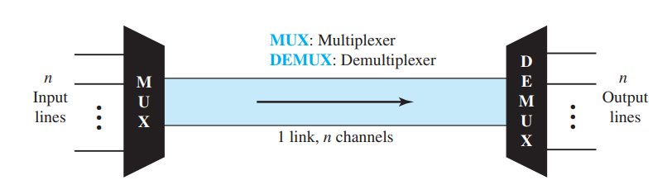

Slide 5
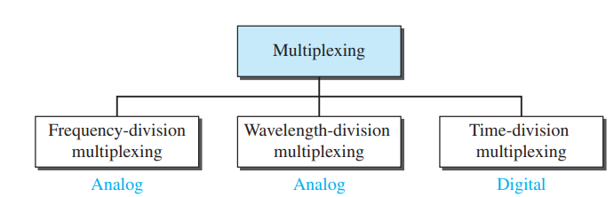
There are three basic multiplexing techniques: frequency-division multiplexing, wavelength-division multiplexing, and time-division multiplexing.

Slide 6
Frequency-Division Multiplexing
Frequency-division multiplexing (FDM) is an analog technique that can be applied when the bandwidth of a link (in hertz) is greater than the combined bandwidths of the signals to be transmitted.
In FDM, signals generated by each sending device modulate different carrier frequencies. These modulated signals are then combined into a single composite signal that can be transported by the link.
Carrier frequencies are separated by sufficient bandwidth to accommodate the modulated signal. These bandwidth ranges are the channels through which the various signals travel.
Channels can be separated by strips of unused bandwidth—guard bands—to prevent signals from overlapping.
In addition, carrier frequencies must not interfere with the original data frequencies.

Slide 7
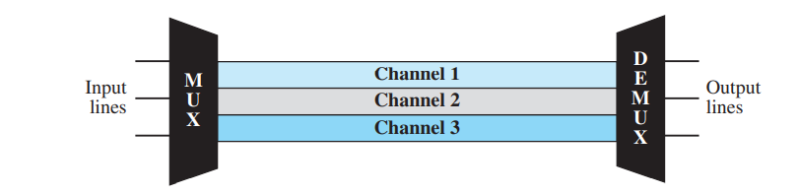

Slide 8
Multiplexing Process
Inside the multiplexer, these similar signals modulate different carrier frequencies ( f1, f2, and f3).
The resulting modulated signals are then combined into a single composite signal that is sent out over a media link that has enough bandwidth to accommodate it.
Demultiplexing Process
The demultiplexer uses a series of filters to decompose the multiplexed signal into its constituent component signals.
The individual signals are then passed to a demodulator that separates them from their carriers and passes them to the output lines.

Slide 9
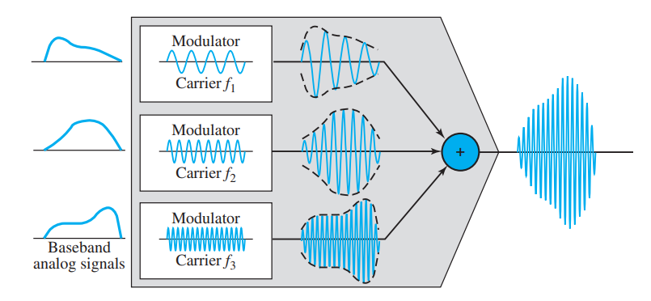
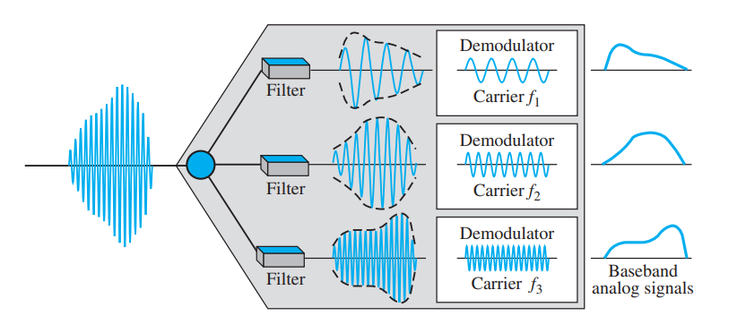

Slide 10
Five channels, each with a 100-kHz bandwidth, are to be multiplexed together. What is the minimum bandwidth of the link if there is a need for a guard band of 10 kHz between the channels to prevent interference?
Solution
For five channels, we need at least four guard bands. This means that the required bandwidth is at least 5 × 100 + 4 × 10 = 540 kHz, a

Slide 11
Wavelength-Division Multiplexing
Wavelength-division multiplexing (WDM) is designed to use the high-data-rate capability of fiber-optic cable.
The optical fiber data rate is higher than the data rate of metallic transmission cable, but using a fiber-optic cable for a single line wastes the available bandwidth.
Multiplexing allows us to combine several lines into one.
Although WDM technology is very complex, the basic idea is very simple.
We want to combine multiple light sources into one single light at the multiplexer and do the reverse at the demultiplexer. The combining and splitting of light sources are easily handled by a prism

Slide 12
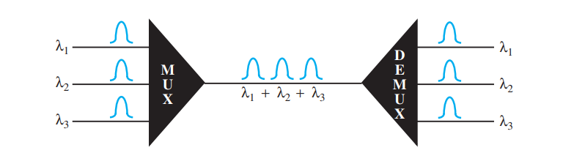
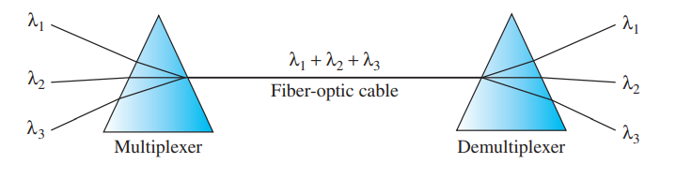

Slide 13
Time-Division Multiplexing
Time-division multiplexing (TDM) is a digital process that allows several connections to share the high bandwidth of a link.
Instead of sharing a portion of the bandwidth as in FDM, time is shared. Each connection occupies a portion of time in the link.

Slide 14
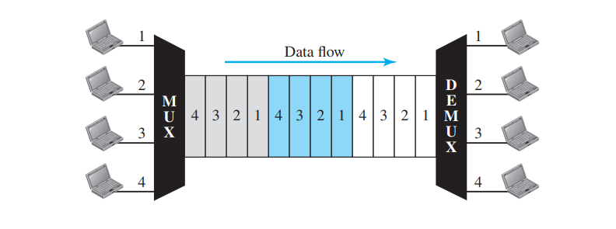

Slide 15
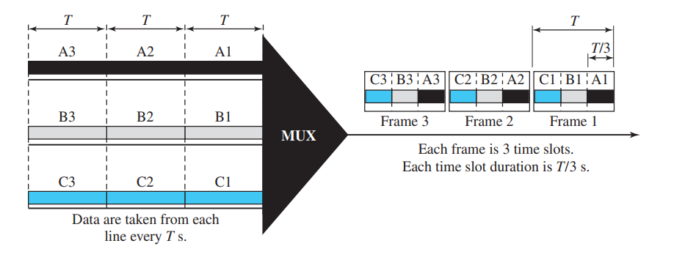
TDM can be divided into two different schemes: synchronous and statistical.
In synchronous TDM, each input connection has an allotment in the output even if it is not sending data.

Slide 16
Multiplexing Process in STDM
1. In STDM every device is given the opportunity to transmit a specific amount of data onto the link.
2. Each device gets its turn in fixed order and for fixed amount of time. This process is known as interleaving.
3. We can say that the operation of STDM is similar to that of a fast interleaved switch. The switch opens in front of a device; the device gets a chance to place the data onto the link.
4. Such an interleaving may be done on the basis of a hit, a byte or by any other data unit.
5. In STDM, the interleaved units are of same size i.e. if one device sends a byte, other will also send a byte and so on.
6. As shown in the fig. interleaving is done by a character (one byte). Each frame consists of four slots as there are four input devices. The slots of some devices go empty if they do not have any data to send.
7. At the receiver, demultiplexer decomposes each frame by extracting each character in turn. As a character is removed from frame, it is passed to the appropriate receiving device

Slide 17
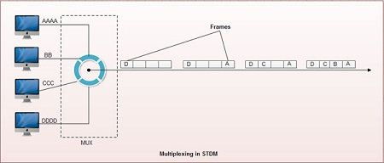

Slide 18
Disadvantages of Synchronous TDM
1. The channel capacity cannot be fully utilized. Some of the slots go empty in certain frames. As shown in fig only first two frames are completely filled. The last three frames have 6 empty slot. It means out of 20 slots in all, 6 slots are empty. This wastes the l/4th capacity of links.
2. The capacity of single communication line that is used to carry the various transmission should be greater than the total speed of input lines

Slide 19
Asynchronous TDM
1. It is also known as statistical time division multiplexing.
2. Asynchronous TDM is called so because is this type of multiplexing, time slots are not fixed i.e. the slots are flexible.
3. Here, the total speed of input lines can be greater than the capacity of the path.
4. In synchronous TDM, if we have n input lines then there are n slots in one frame. But in asynchronous it is not so.
5. In asynchronous TDM, if we have n input lines then the frame contains not more than m slots, with m less than n (m < n).
6. In asynchronous TDM, the number of time slots in a frame is based on a statistical analysis of number of input lines.
7. In this system slots are not predefined, the slots are allocated to any of the device that has data to send.
8. The multiplexer scans the various input lines, accepts the data from the lines that have data to send, fills the frame and then sends the frame across the link.
9. If there are not enough data to fill all the slots in a frame, then the frames are transmitted partially filled.

Slide 20
